Slide 1
Uncapped Art References
Table of Contents
Page. | Title
1 | MetalSkinPanic Arm 1
2 | MetalSkinPanic HUD
3 | MetalSkinPanic Maddox Suit
4
5
5
Page. | Title
7
8
9
10
11
12
Page. | Title
13
14
15
16
17
18

Slide 2
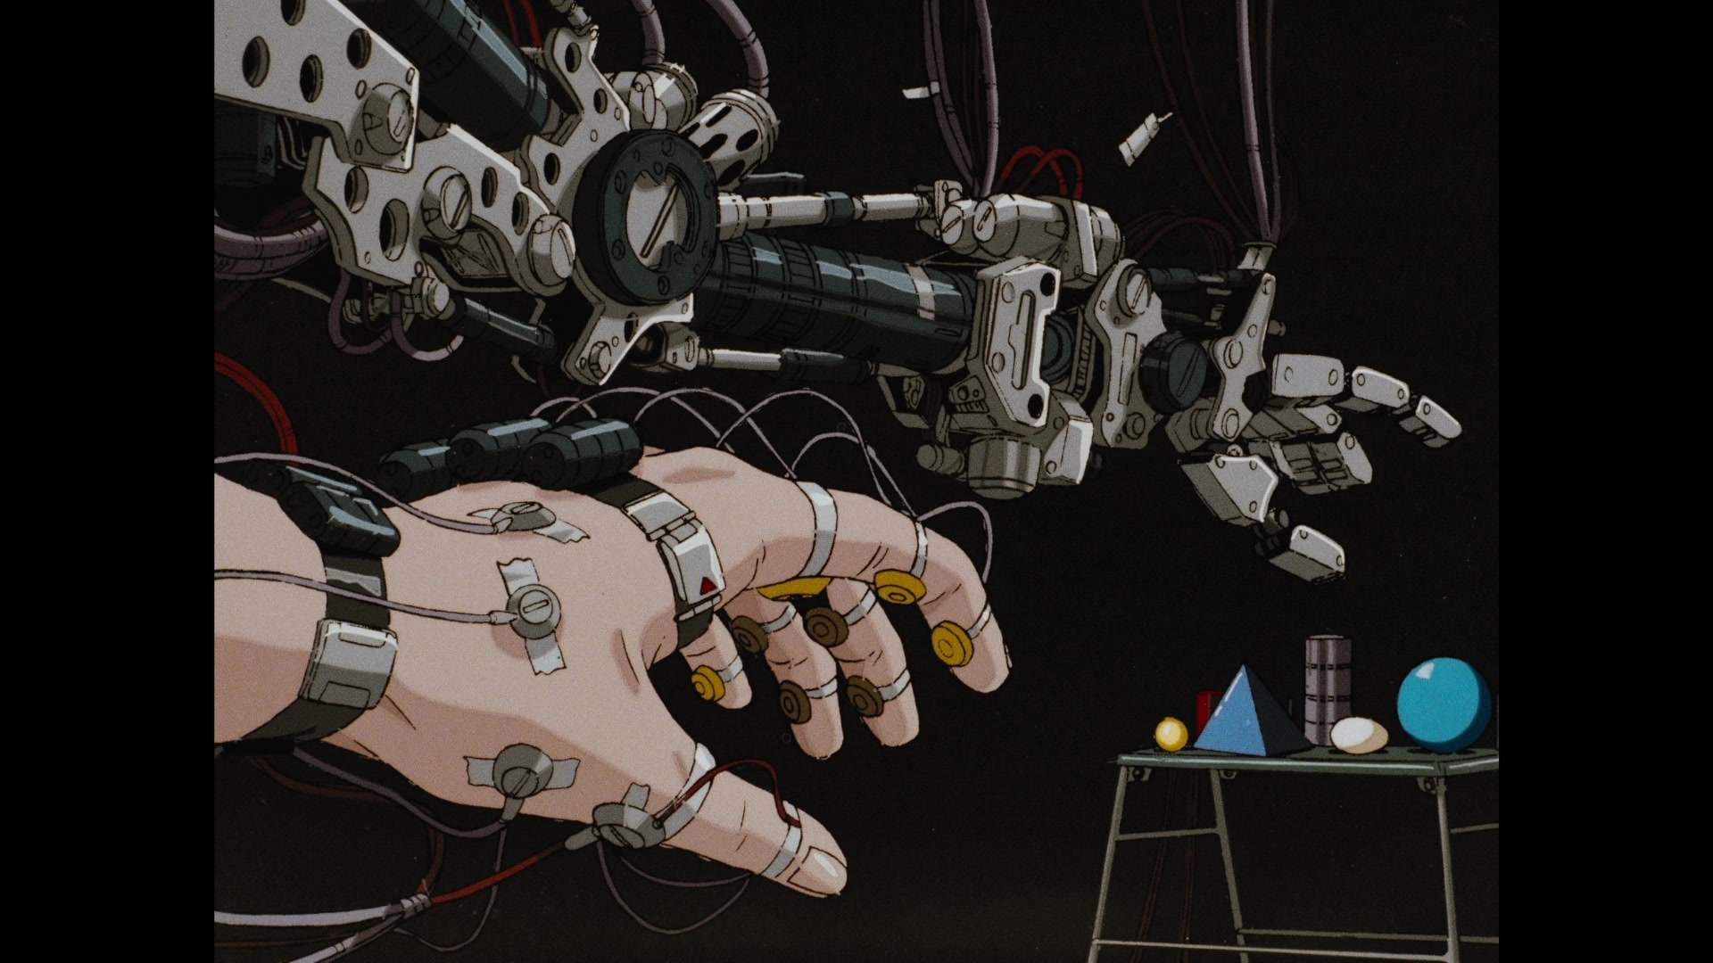
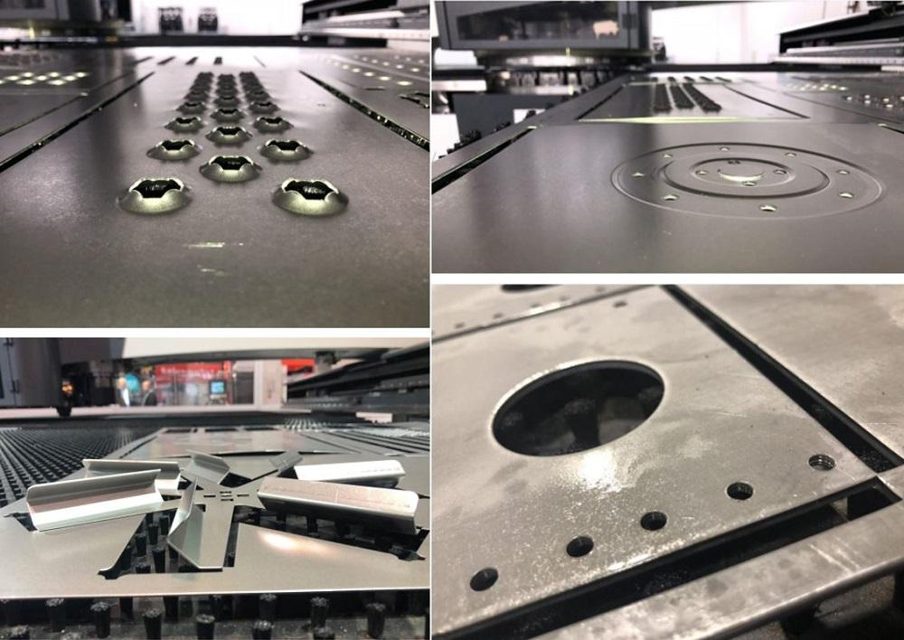
MetalSkinPanic Arm 1
- Hydraulic lines for articulation
- Oil lines/grease ports at joints
- Punched/pressed steel plating
- Reduce chassis weight
- Reduce load on articulation
motors
- Better cooling of motors
- Allows for bolts & fasteners to
be placed in other configs
for different loadouts
- Flush Rivet fasteners
- Primitive shapes
- Complex parts are multiple
primitives fastened together
- No CNC machined parts,
only cut, formed, cold roll
- Wrist articulates in one axis
Punch/Press Plating Reference
- Hydraulic pumps for articulation
- Expensive/easy breakdown requires
armor plating

Slide 3
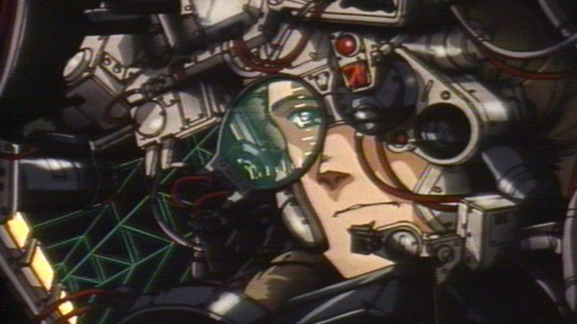
MetalSkinPanic HUD
- Primitive single LED for status indicators
- Bulky Telephoto lens
- Function over form, industrial
manufacturing was still early
so features were larger
- Transparent lens with Sonar
CRT projected on top for target tracking
- Scaffolding gets welded at intersections
- Lightest weight framing

Slide 4
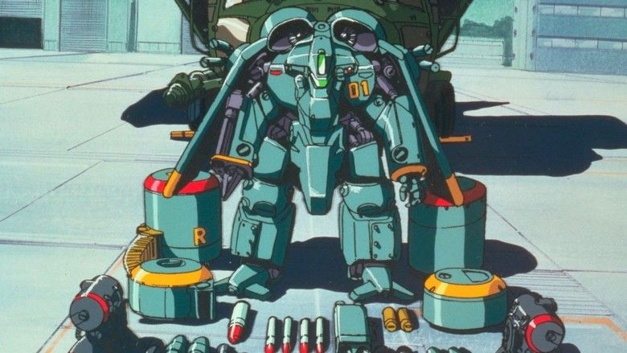
MetalSkinPanic Maddox Suit
- Premium/Enterprise grade models could afford formed chassis
- Ballistics deflection
- Show of power/wealth to enemies
- Brushed/Blued steel and anti rust coasting
- Internal framing visible underneath chassis
- Hydraulics vulnerable, necessary to reduce
frame weight and allow mobility
- Red/Orange paint to indicate
warnings
- “This Side UP” on ammo
- Wing tips as visual indicator
to prevent collisions
- Back blast zone
- Painted insignia, serial no., company affiliation
- Belt Fed ammunition
- Basic Cylinder with radius caps

Slide 5
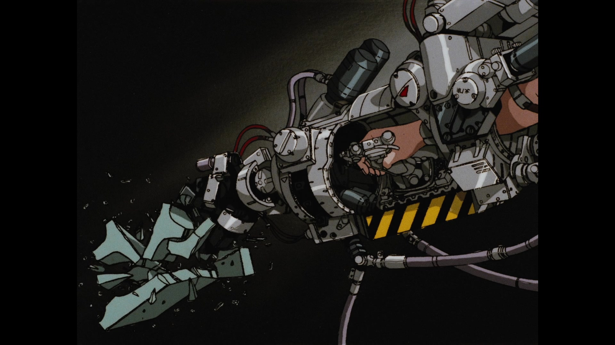
MetalSkinPanic Arm 2
- Cylinder primitives
- Oil lines, hydraulics
- Steel framing is enveloped around
parts that need protection, unoptimized
- Large bolts/caps
- Multiple consecutive fasteners
- Oil lines, hydraulics

Slide 6
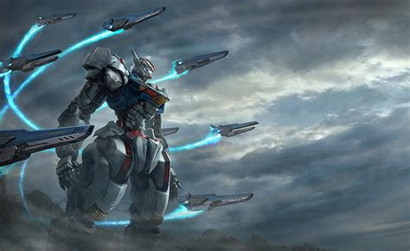
GundamAeriel_Missiles
- Natural earth tones of scenery contrasted
by unnatural bright neon trails

Slide 7
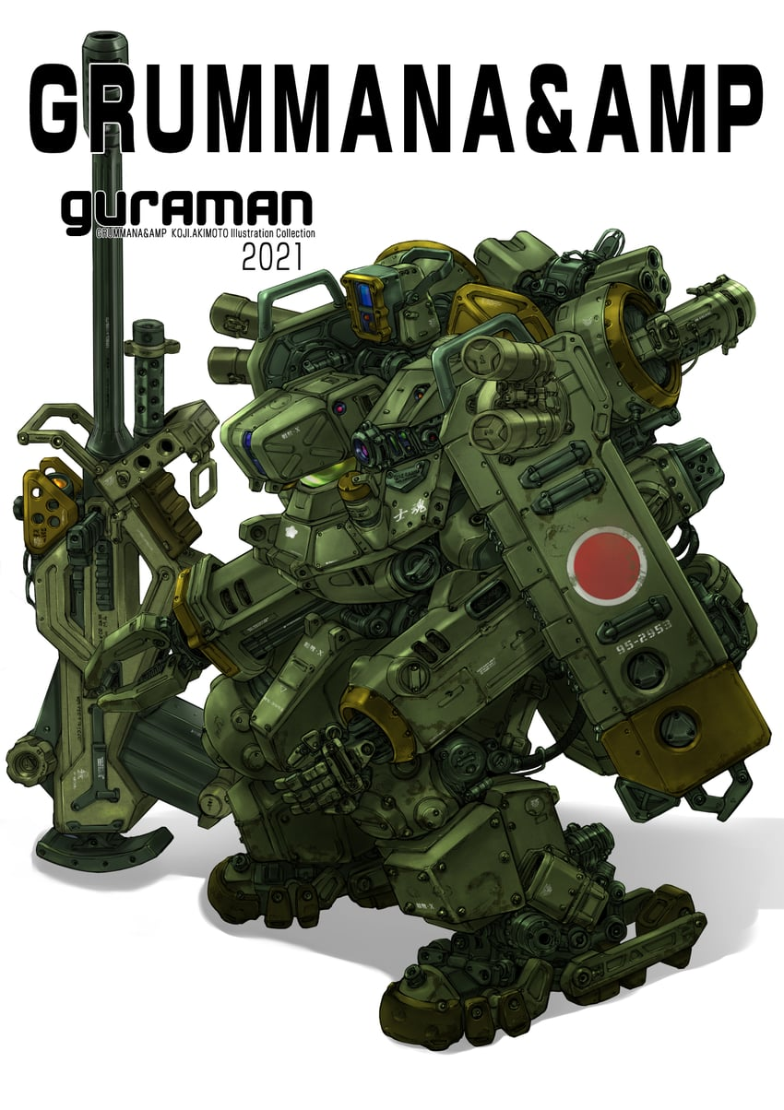
MetalSkinPanic_Madox_2
- Hand rails for service techs to mantle the frame
-Flare/Chaff deployment
- Punch/Pressed metal for cooling
- Accessory holsters

